Slide 1
Texas Voting Database
Team Members: Sunny Bhatt, Kristal Conception, Zane Rios, Chloe Valverde

Slide 2
What/Why: Texas is an immense state full of varying demographics nurturing different ideologies.
With this vast amount of space, it is paramount to know where you can vote.
It is also good to know where your area stands politically, especially if you are deciding to move to an area with certain political inclinations.

Slide 3
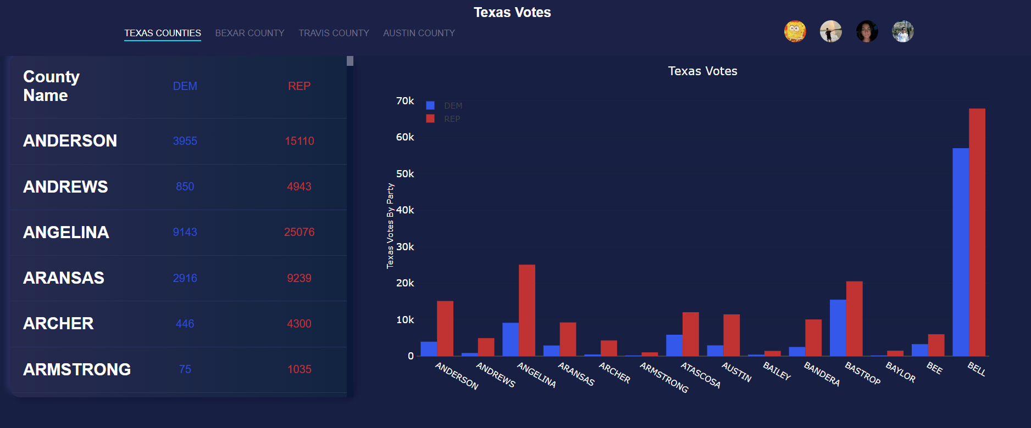

Slide 4
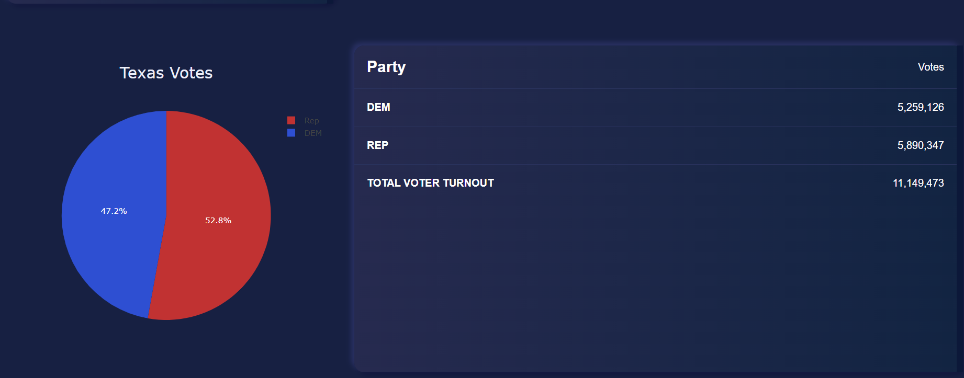

Slide 5
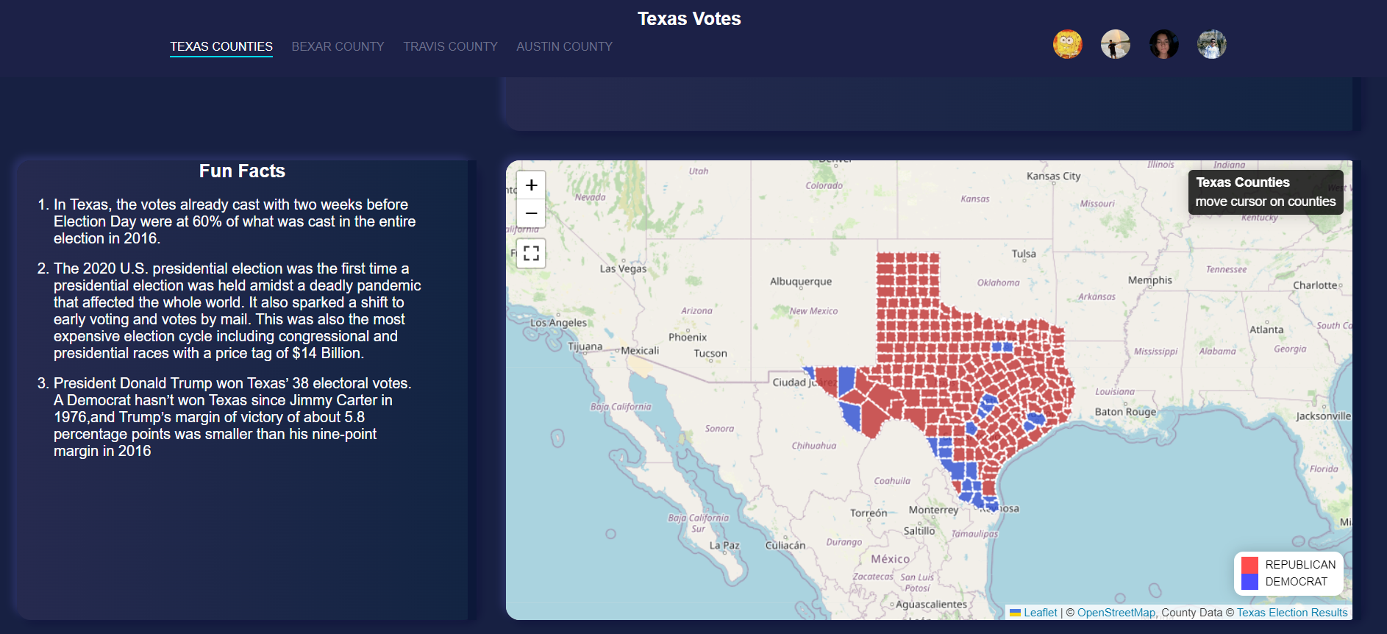

Slide 6
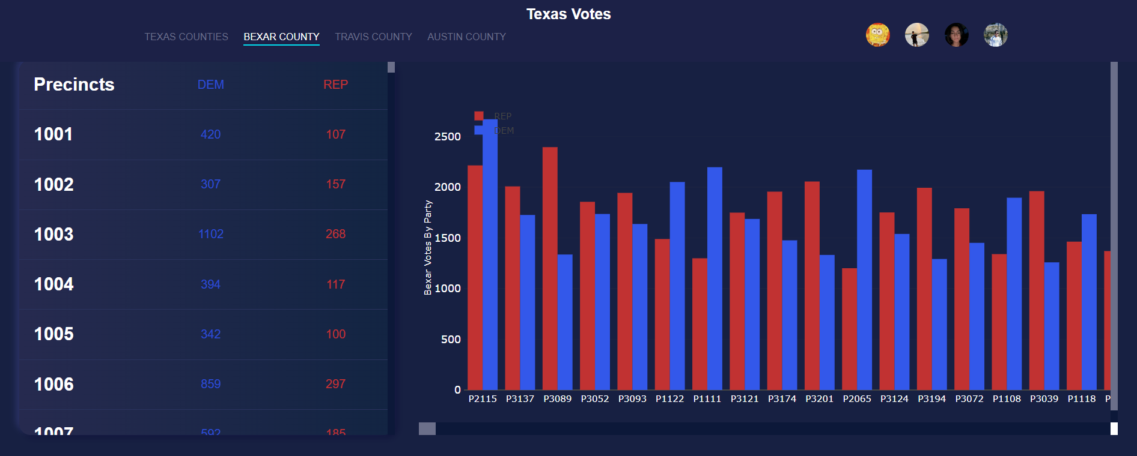

Slide 7
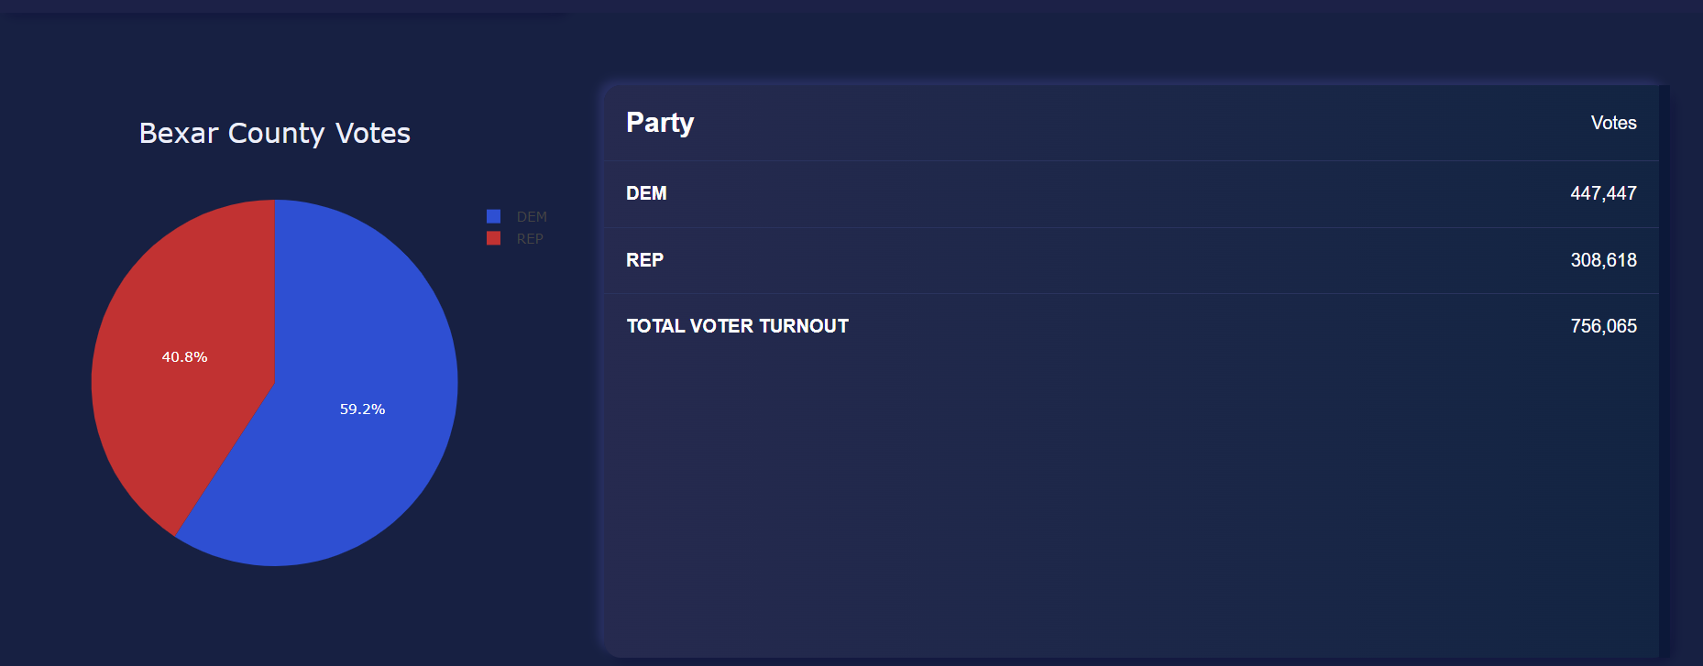

Slide 8
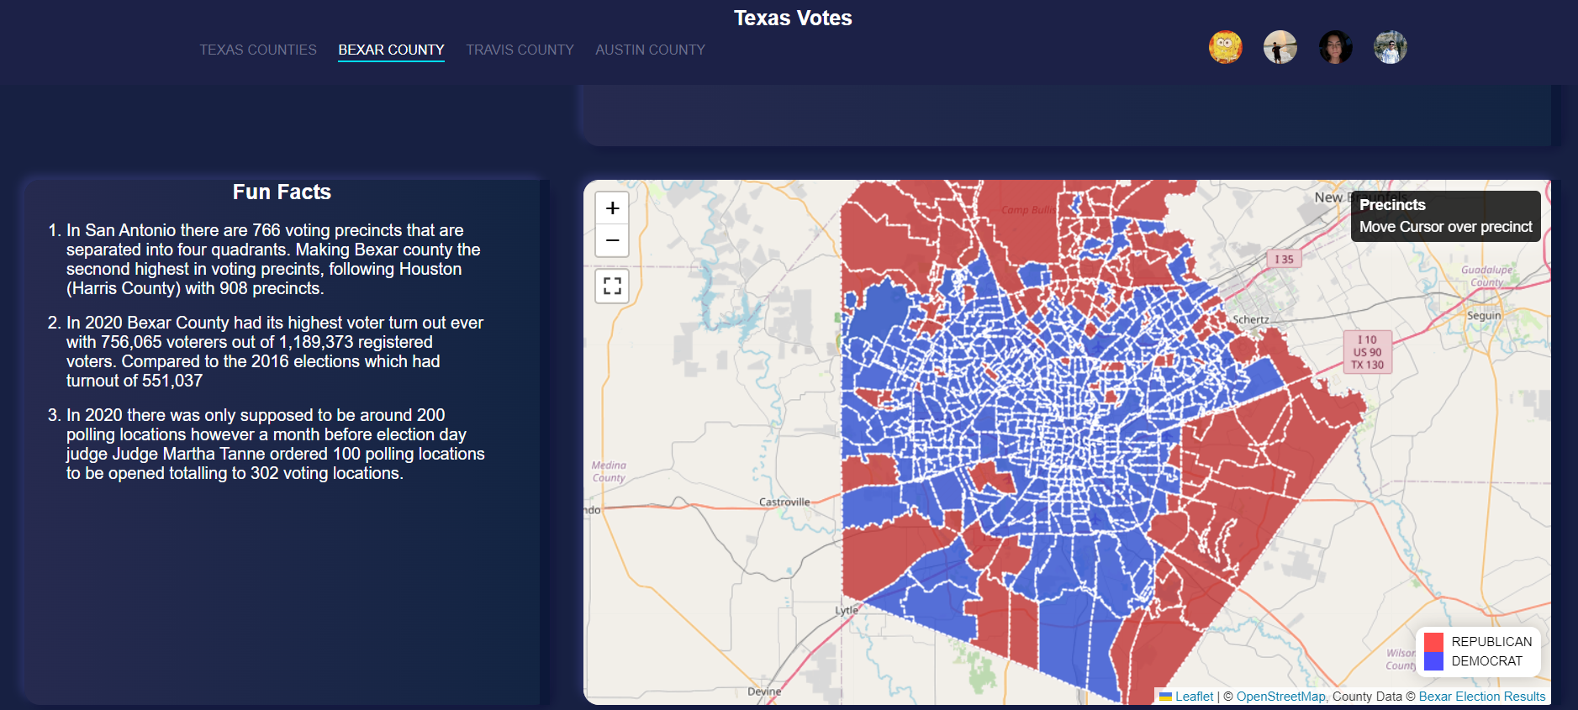

Slide 9
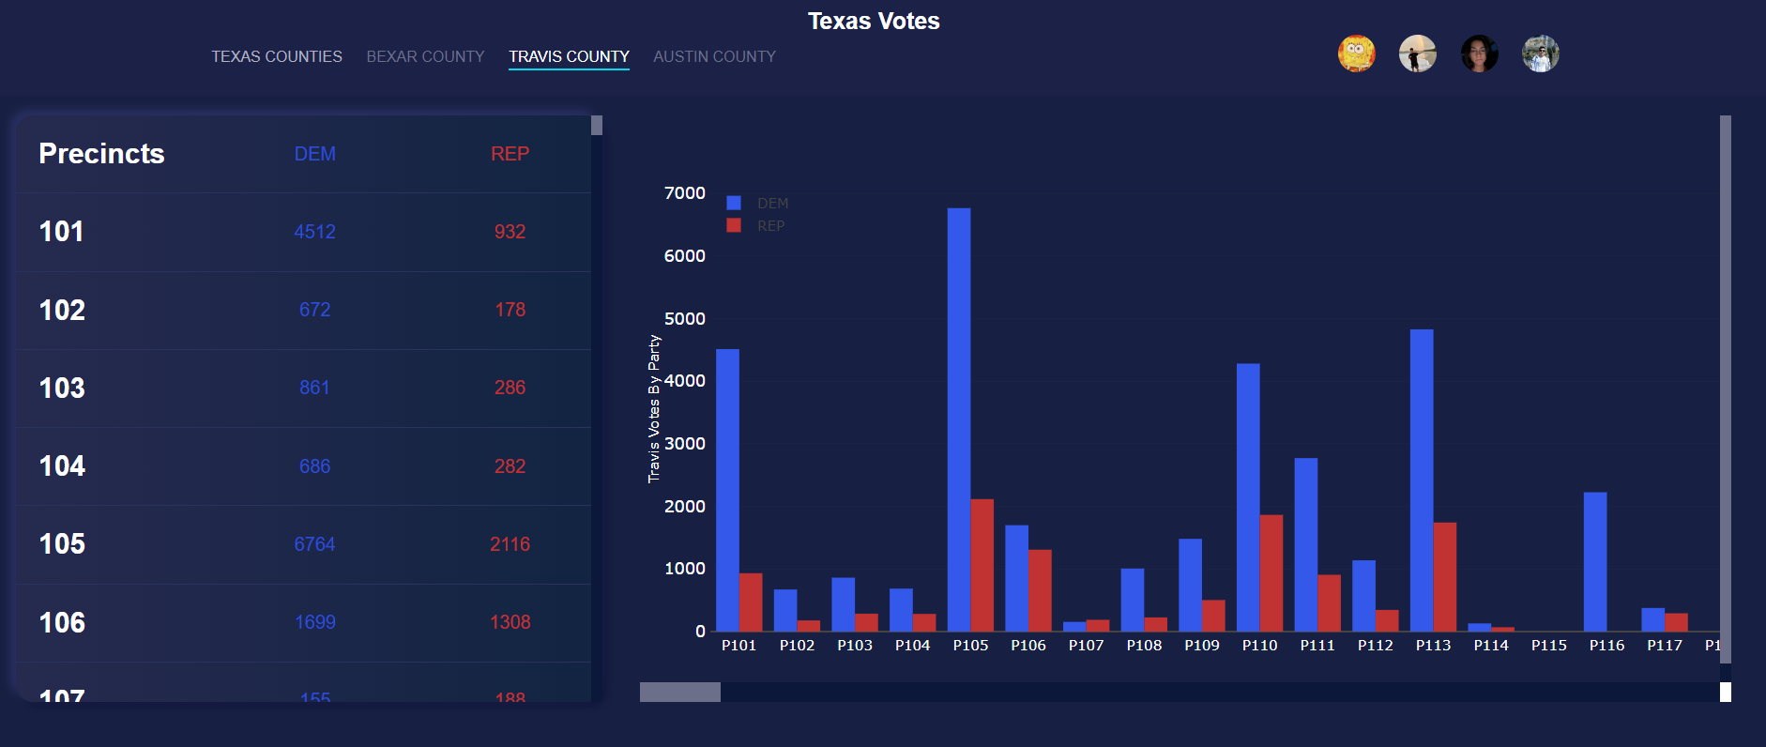

Slide 10
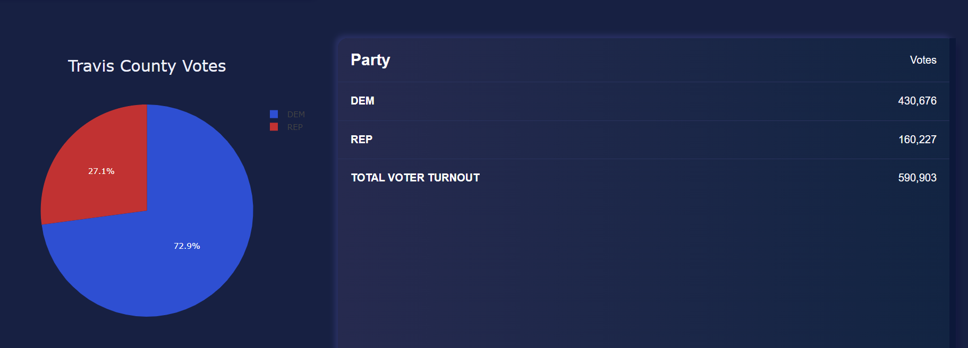

Slide 11
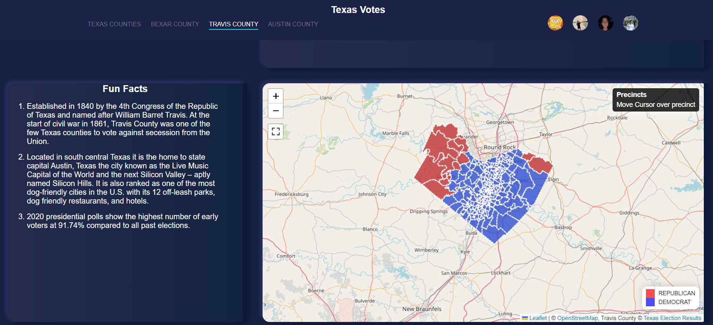

Slide 12
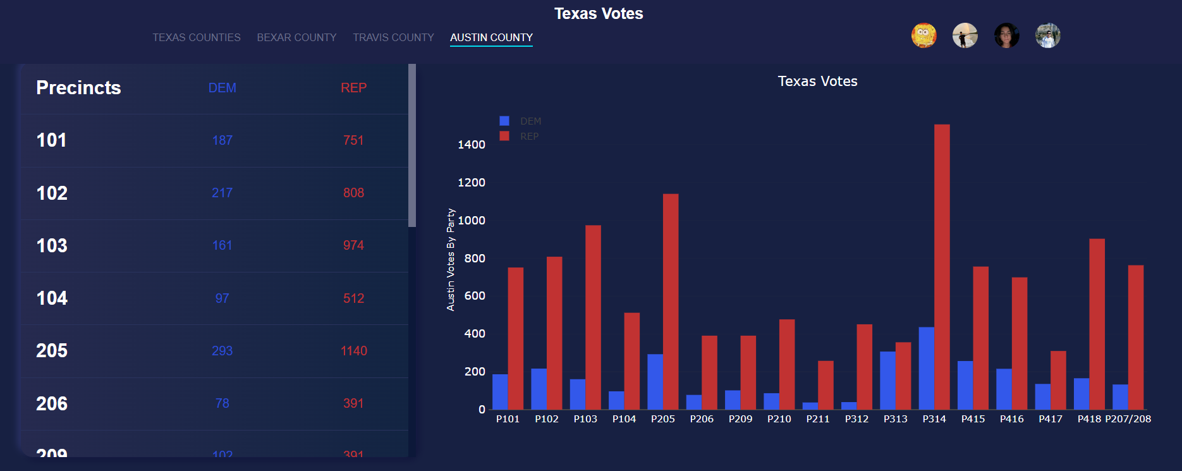

Slide 13
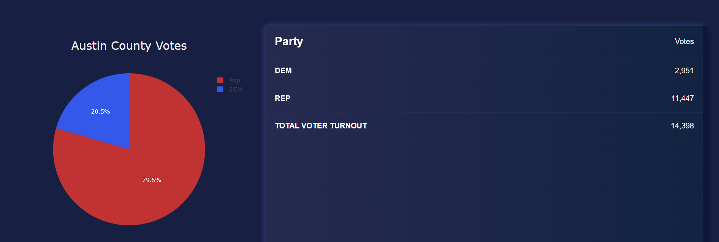

Slide 14
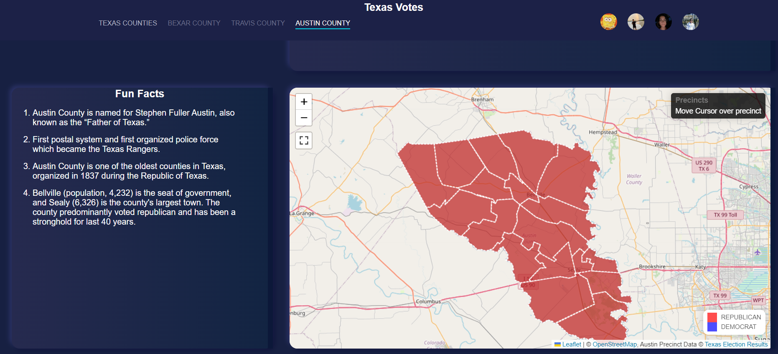

Slide 15
CONCLUSION

Slide 16
QUESTIONS

